Slide 1
What kind of paid application should a developer develop to the App Store?
An Analysis of Apple App Store Dataset
Aybüke Meydan

Slide 2
Develop A Paid App For App Store
Client:Freelance IOS Developer.
Problem:Choosing an application in the preferred size, price and category

Slide 3


METHODOLOGY
Counting the paid app category
Find the profittable category
Decide size and price

Slide 4
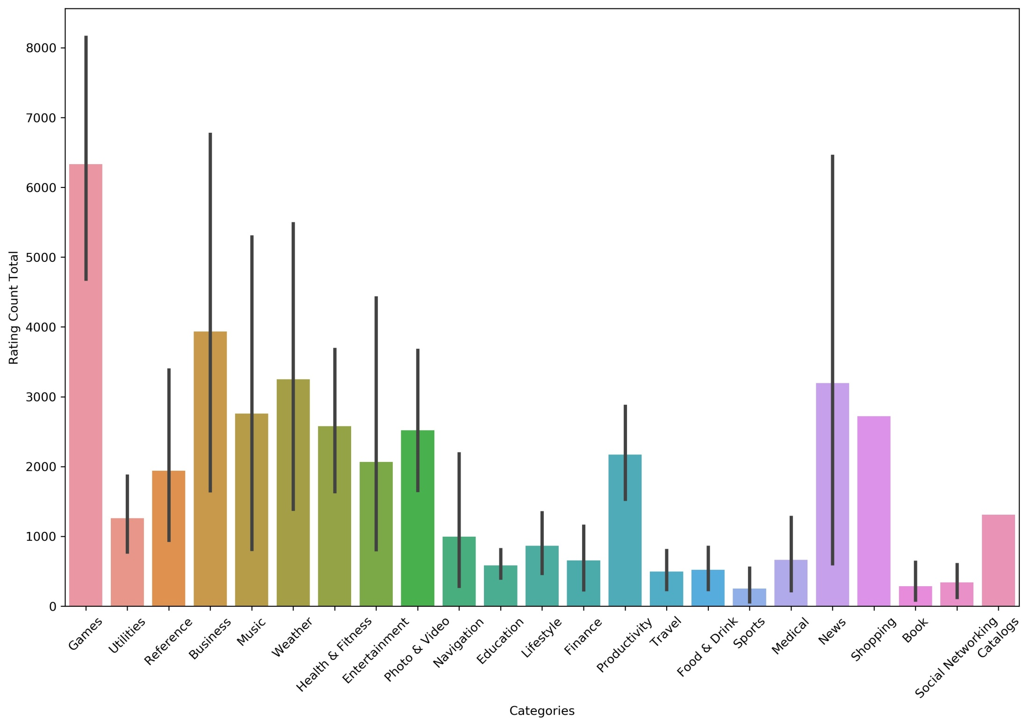

Slide 5
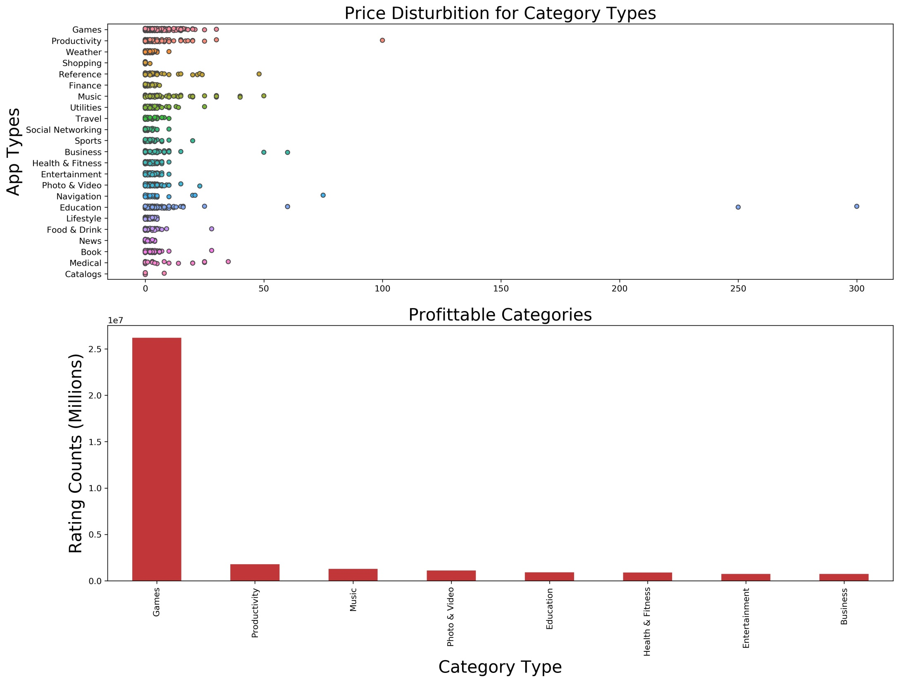

Slide 6
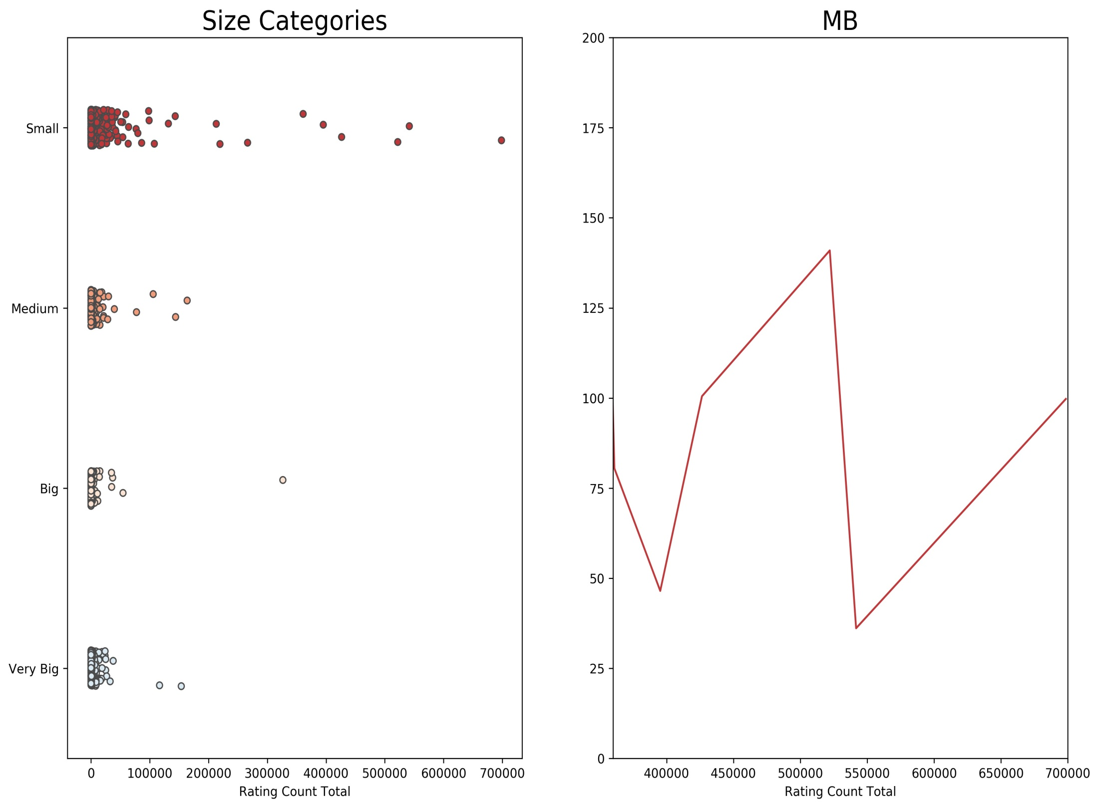

Slide 7
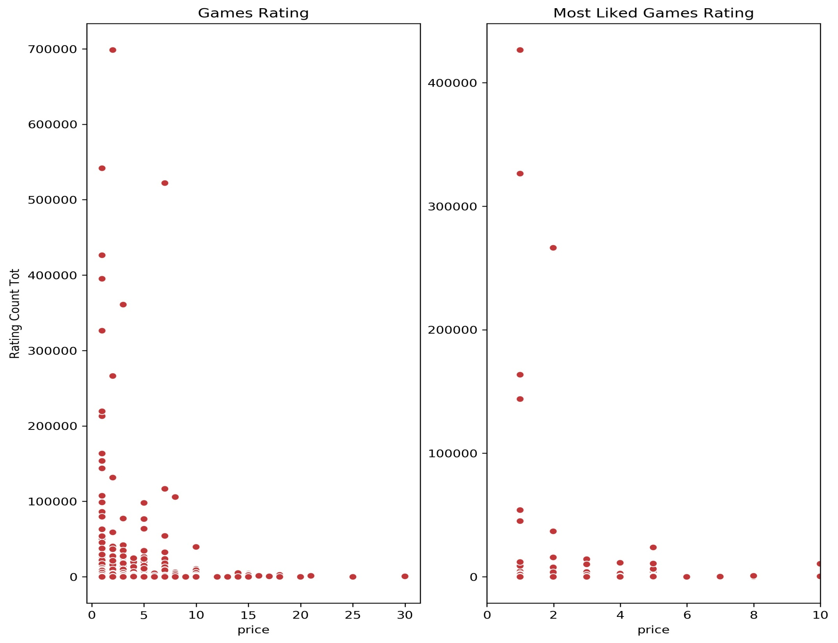

Slide 8
Recommendation
The Best Candidate of App Category: GAMES
The highest MB that should be selected: 100
Best Price Range: Min 1 USD Max 2 USD

Slide 9
FUTURE WORKS
1. Which words should I use for an effective description? Do people look at the description while downloaded the application? Which words are the most mentioned in the definitions?
2. What is the effect of supported languages on the number of rating?
3. Sentimental analysis of user comments

